Slide 1

Our Plan to Combat Climate Change:
How You Can Make The Difference
Group 5
Ethan Radecki​
Malhar Mahajan​
Jaswanth Srinivas Chandu Meesala
​
Shuai Liu​

Slide 2



Introduction
The energy company (eCS) anticipates a significant surge in energy demand next summer, driven by global warming and exceptionally hot weather, particularly in July—historically the peak month for energy usage.
This increased demand poses a risk of blackouts unless proactive measures are taken.
Predictive Modeling: Create a model to predict energy usage while accounting for the impact of global warming on temperature patterns.
Key Driver Identification: Identify the primary factors driving peak energy consumption.
Sustainability: Support eCS’s environmental sustainability goals by reducing carbon footprints and mitigating the need for new energy production facilities.
Energy Demand Prediction: Analyze contributing factors and develop a model to predict future energy demand, specifically for the next year.
Customer Strategies: Develop strategies to encourage customers to adopt energy-saving behaviors to manage demand and meet eCS's goal of avoiding additional energy infrastructure investment.

Slide 3
Data Overview, Integration and Validation
Datasets
Data Integration
Data Validation
Static House Data
Contains information about houses, including:
  Unique building ID
  Square footage
  City and county
  Number of rooms
  Number of occupants
Merged the Static House and Energy Data datasets based on the unique Building ID (bldgid) column.
Missing Values
There were no missing values (NA's) in the primary dataset and Weather data set.
A single NA row was found in each energy data URL, which was removed during the merging process.
Filtered the data for July, as this is the target month for analyzing peak energy demand.
Energy Data
It contains:
Hourly energy consumption data for each house, covering:
Energy use by appliances and electrical system
Data Integrity Check:
Validated the dataset based on expected record counts to ensure completeness and accuracy after merging.
Combined the merged data with Weather Data, linking based on the County ID and Time to correlate energy usage with weather conditions.
Weather Data
Hourly weather data for each county, including:
Temperature, humidity, wind speed, and other relevant weather parameters
5710
Bldg ID
31 Days
24 Hr
*
*
=
4248240

Slide 4

Selection of Variables
Objective
The primary goal in model development is to create a robust and generalized predictive model
that performs well on unseen data, avoiding overfitting.
The following variables were selected based on their statistical significance (p-value < 0.05) and their correlation with the target variable, totalenergy.
Types of Variables
Continuous Variables
Categorical Variables
Interaction Terms
Dry Bulb Temperature [°C]
in.sqft (Square Footage)
in.occupants (Number of Occupants)
Wind Speed [m/s]
Relative Humidity [%]
in.hvac_cooling_type (Cooling Type)
in.geometry_wall_type (Wall Type)
timezone (Timezone)
In.lighting (type of lighting)
in.hvac_cooling_type * Dry Bulb Temperature [°C]
Relative Humidity [%] * Dry Bulb Temperature [°C

Slide 5
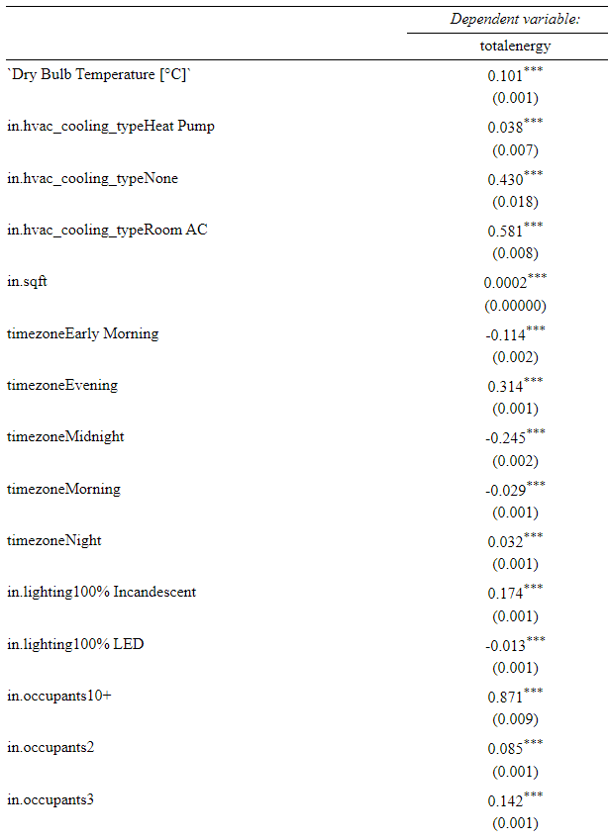
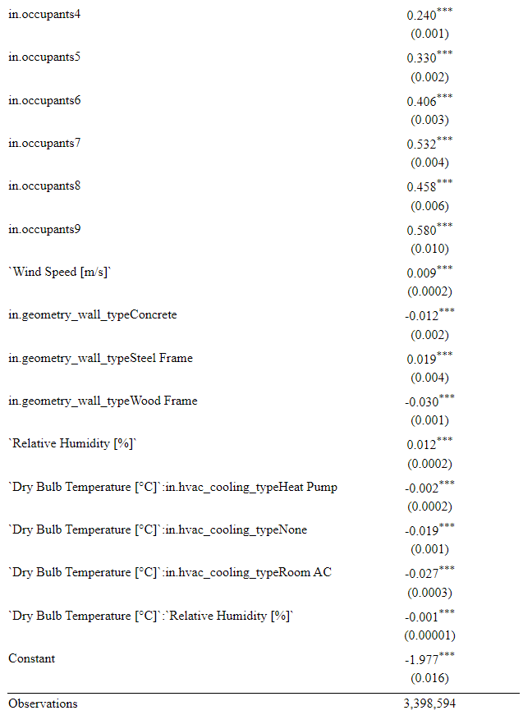
Regression Model Output

Slide 6
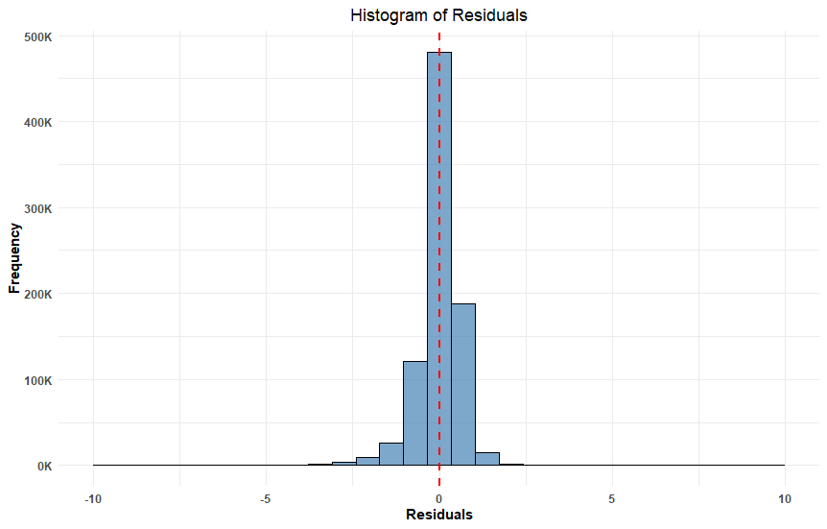
Evaluating Our Model's Accuracy
Plotting Residuals
Mean Absolute Error:
.421
Adjusted R-Squared:
.3655
Moderate Prediction Errors
Room for Improvement

Slide 7
Difference in Total Energy Demand
Total Current Demand for July
Total Predicted Demand for Next July
5,225,516 kWh
6,458,737 kWh
~23% Increase

Slide 8
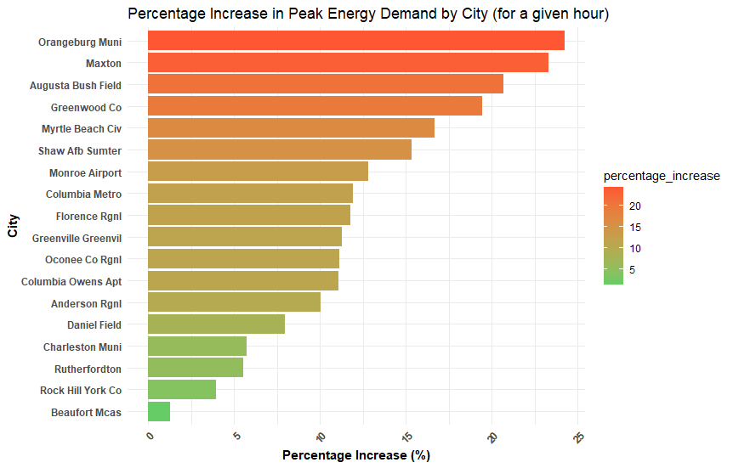
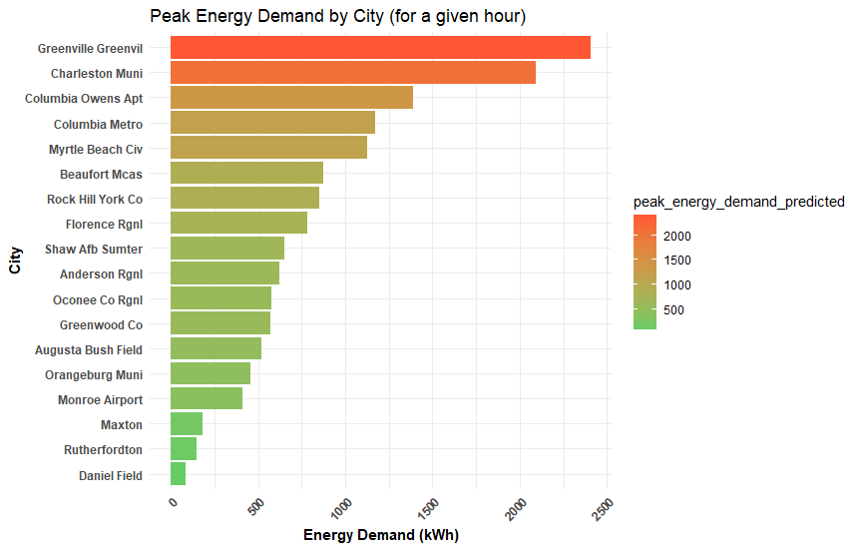
Predicting Peak Energy Demand by City
Predicted % Increase of Demand
Predicted Total Demand Increase

Slide 9
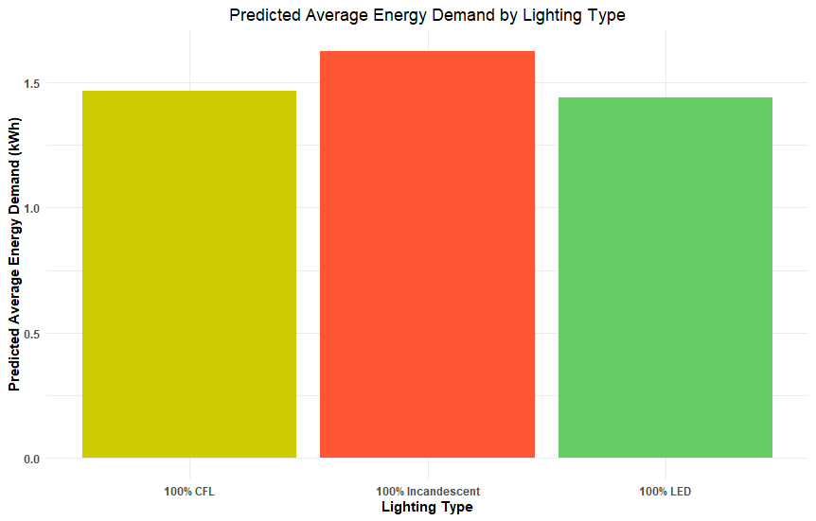
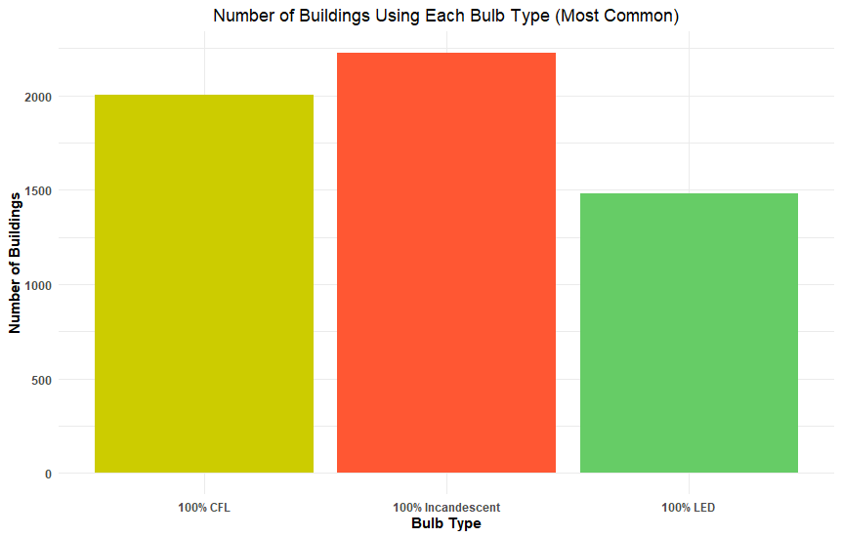
A Simple Lighting Shift for Impact
Predicted Average Demand By Lighting
How Common Each Type Is

Slide 10

A Simple Lighting Shift for Impact
Our Approach
Convert 25% of Incandescent Bulb Users to LED Users
Convert 25% of CFL Bulb Users to LED Users
Total Predicted Energy Demand Decreases by 82,475 kWh for Next July

Slide 11

Thank You

